Slide 1
The Fixed Disposition Effect
Qinglin Ouyang
Stockholm Business School, Stockholm University
Shumiao Ouyang
Saïd Business School, University of Oxford
Oxford Saïd FAME Seminar
November 19, 2025

Slide 2
Fourty Years of Disposition Effect
Disposition effect (DE) has been shown to widely exist:
  at aggregate level (Shefrin & Statman, 1985; Odean, 1998),
  across countries (An et al., 2024; Kaustia, 2010),
  across roles: retail and institutional investors (Grinblatt & Keloharju, 2001), financial advisors (Andries et al., 2024),
  across asset types: commodity (Locke & Mann, 2005), options (Pitkäjärvi et al., 2025), real estate (Genesove & Mayer, 2001),
  in investment experiments (Weber & Camerer, 1998),
  and with great cross-sectional heterogeneity (Dhar & Zhu, 2006).
Implicitly or explicitly, DE has been considered a universal bias.
  However, can DE be individual-specific?
Ouyang & Ouyang
The Fixed Disposition Effect
1/30

Slide 3
Overview of the Paper
Unique interconnected individual-level data
  Chinese retail investors during Jan 2017 - Oct 2021
  Large-scale gamified experiment
  Real-life mutual fund holdings
The DE acts like an individual fixed effect manifested by
  over-time persistence
  cross-context consistency
Irrational beliefs and non-traditional preference are relevant:
  Strong DE among contrarians, minimal among extrapolators
  A salient jump in selling propensity around zero-return point, for both types of investors
Ouyang & Ouyang
The Fixed Disposition Effect
2/30

Slide 4
Contribution to the Literature
Verify and reconcile of two potential drivers of DE:
  Extrapolative beliefs (Odean, 1998; Grinblatt & Keloharju, 2001; Kaustia, 2010; Ben-David & Hirshleifer, 2012, Andersen et al., 2025)
    A regression-based belief measure
  Realization preference (Baberis & Xiong, 2009, 2012; Ingesroll & Jin, 2013; Frydman et al., 2014)
    A granular and modern trading/gaming setup
Novel evidence for the effect of stakes on investment mistakes, owing to the virtual trading game, which is
  uncorrelated to personal wealth (Andersen et al., 2022)
  uncorrelated with current market conditions (Sui & Wang, 2025)
Ouyang & Ouyang
The Fixed Disposition Effect
3/30

Slide 5
The Experiment

Slide 6
Experiment Background
Experiment platform: Alipay
  A “subsidiary” of Alibaba Group
  Designed for Taobao E-shopping platform in early 00s’
  Now: Payment + credit provision + wealth management
  Over one billion monthly active users as of 2024
  AUM $560B as of Jun 2020 according to its IPO docs
Voluntary experiment: a virtual investment game
  Launched in July 2019
  Branded as a financial personality test
  Embedded in Alipay mobile app, free to participate
  ~ 20m participants by the end of 2021
Ouyang & Ouyang
The Fixed Disposition Effect
4/30

Slide 7

Experiment Setup
Two assets:
  1 risky asset
  1 risk-free asset (zero return)
Initial endowment: 10,000 CNY
Decision: buy/hold/sell
  1 blind decision at first
  10 “informative” decisions
Ouyang & Ouyang
The Fixed Disposition Effect
5/30

Slide 8
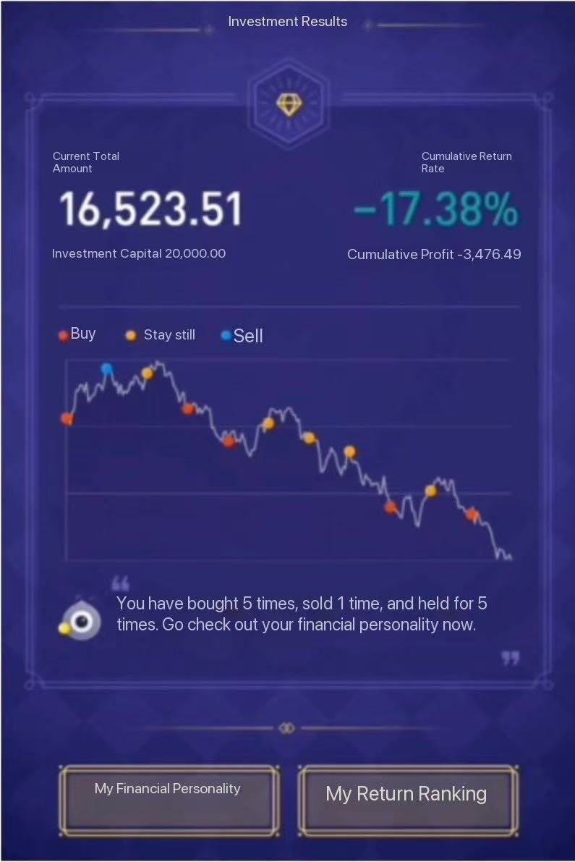
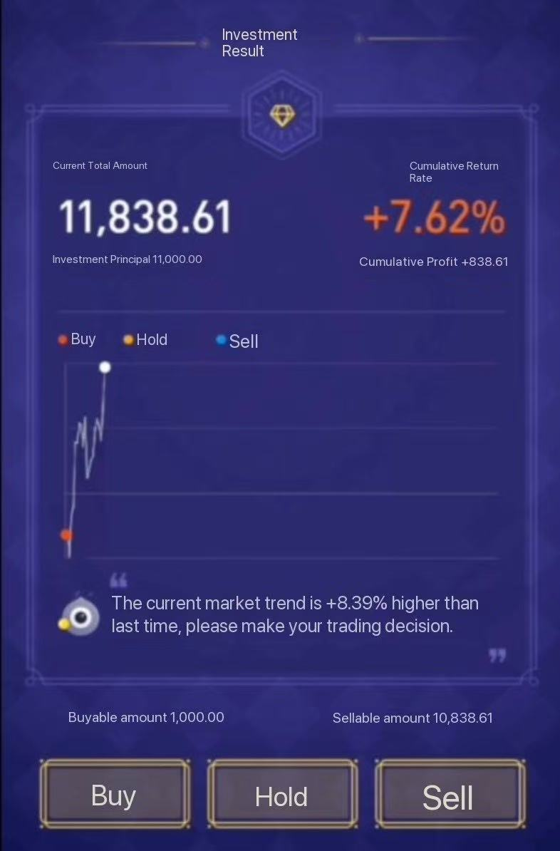
Experiment Setup (Cont’d)
  Before each decision, the player gets a cash inflow of 1,000 CNY, with the interface displaying
    Price movement
    Current performance
    Decision history
  After final decision, the game runs for another period, and then a test report is delivered.
Ouyang & Ouyang
The Fixed Disposition Effect
6/30

Slide 9
Experiment Setup (Cont’d)
  Game data reflects actual Shanghai Composite Index
    A total of 9 years: 2011-2018
    A game equivalent to 11 months
    An in-game decision period is approx. one month
    8 years x 20 scenarios/year = 160 different price paths
An exemplary market condition based on 2011’s index
Ouyang & Ouyang
The Fixed Disposition Effect
7/30

Slide 10
The Fixed Disposition Effect

Slide 11
Baseline Sample
Random sample of 50,000 multi-time participants
  More passionate about financial markets
  More likely to trade, at both extensive and intensive margins
  For more reliable detection of behavioural patterns
  Median (average) of 20 (50) days between two consecutive games
  Another group of one-time players used for robustness check
Collection of decision-level observations
  All in-game periods pooled together
  Excluding the first blind decisions
  Each participant has at least 50 data points
Link to their actual mutual fund holdings via Alipay
  January 2017 – October 2022 at investor-fund-monty level
  Excluding investors with less than 100 fund-month observations
Ouyang & Ouyang
The Fixed Disposition Effect
8/30

Slide 12
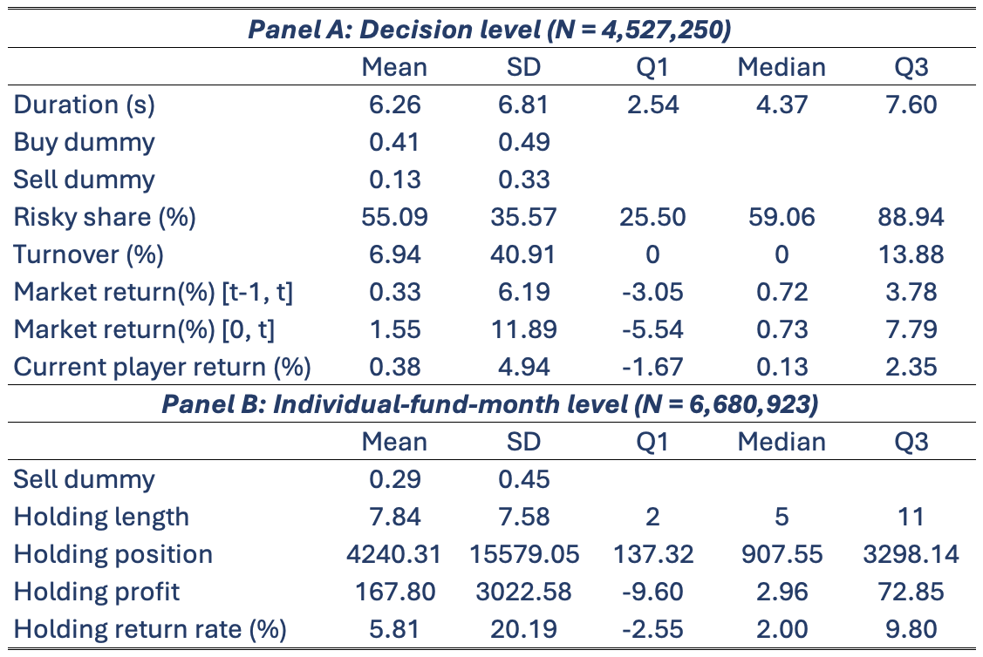
Descriptive Statistics
Ouyang & Ouyang
The Fixed Disposition Effect
9/30

Slide 13
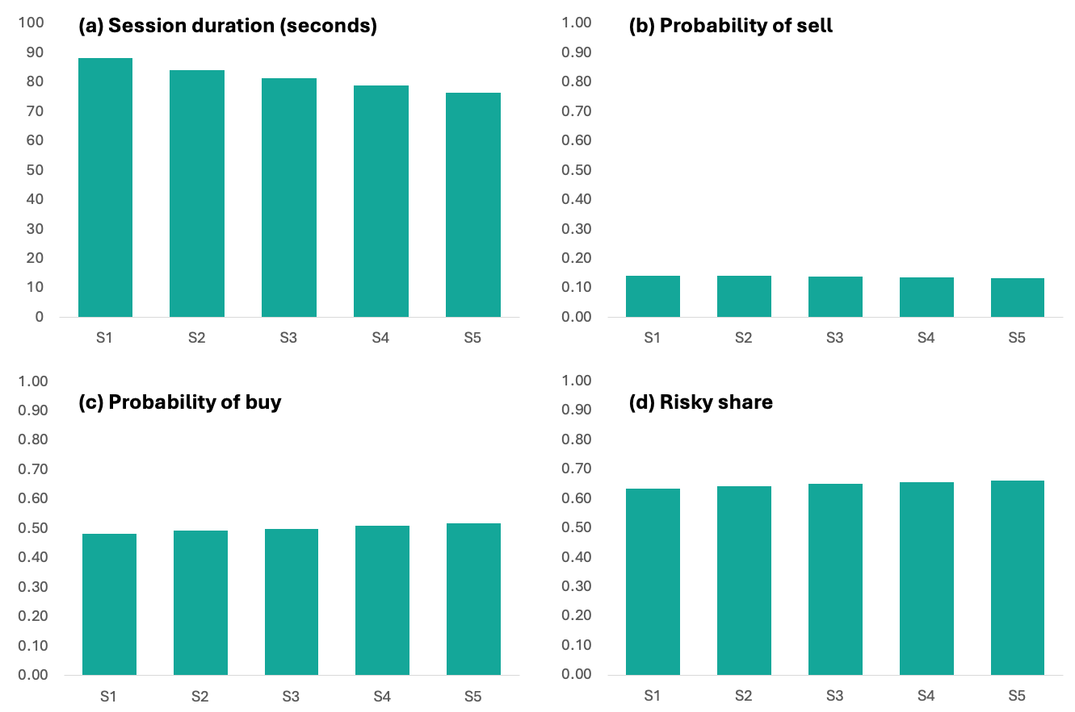
Characteristics over Game Sessions
Ouyang & Ouyang
The Fixed Disposition Effect
10/30

Slide 14
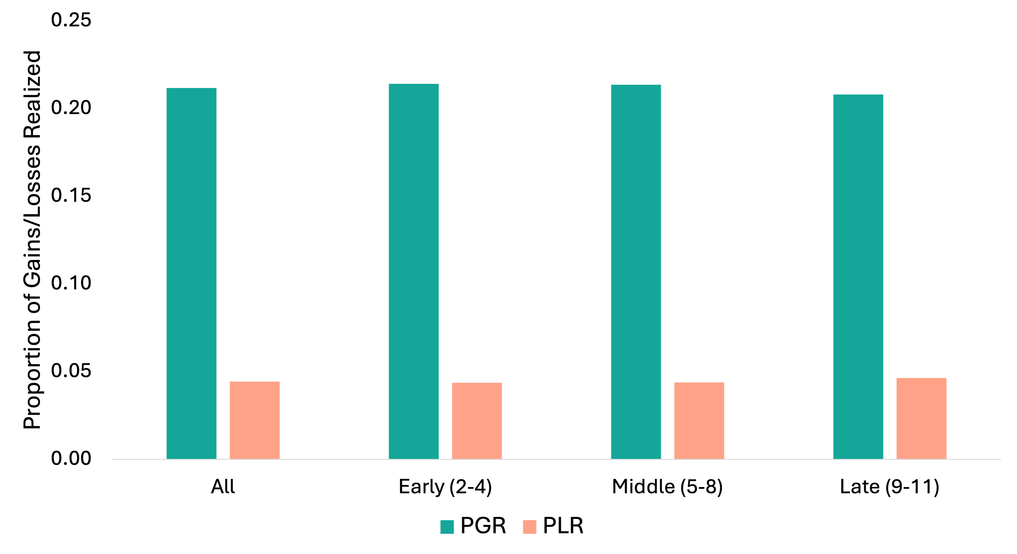
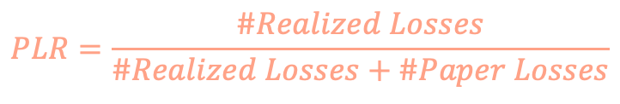
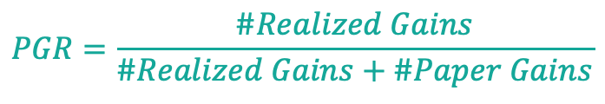
Aggregate DE in Game
$$PGR=\frac{\#Realized Gains}{\#Realized Gains+\#Paper Gains}$$
$$PLR=\frac{\#Realized Losses}{\#Realized Losses+\#Paper Losses}$$
Probability of selling winning vs. losing position (Across stages)
Ouyang & Ouyang
The Fixed Disposition Effect
11/30

Slide 15
Fixed DE: Testable Prediction I
Over-time persistence
  Are investors with higher DE today more likely to have higher DE in the future?
    Mutual fund holdings split into two time periods
  Are game participants with higher DE this session more likely to have higher DE in the following sessions?
    Leverage the DE from last game to predict the next
Ouyang & Ouyang
The Fixed Disposition Effect
12/30

Slide 16
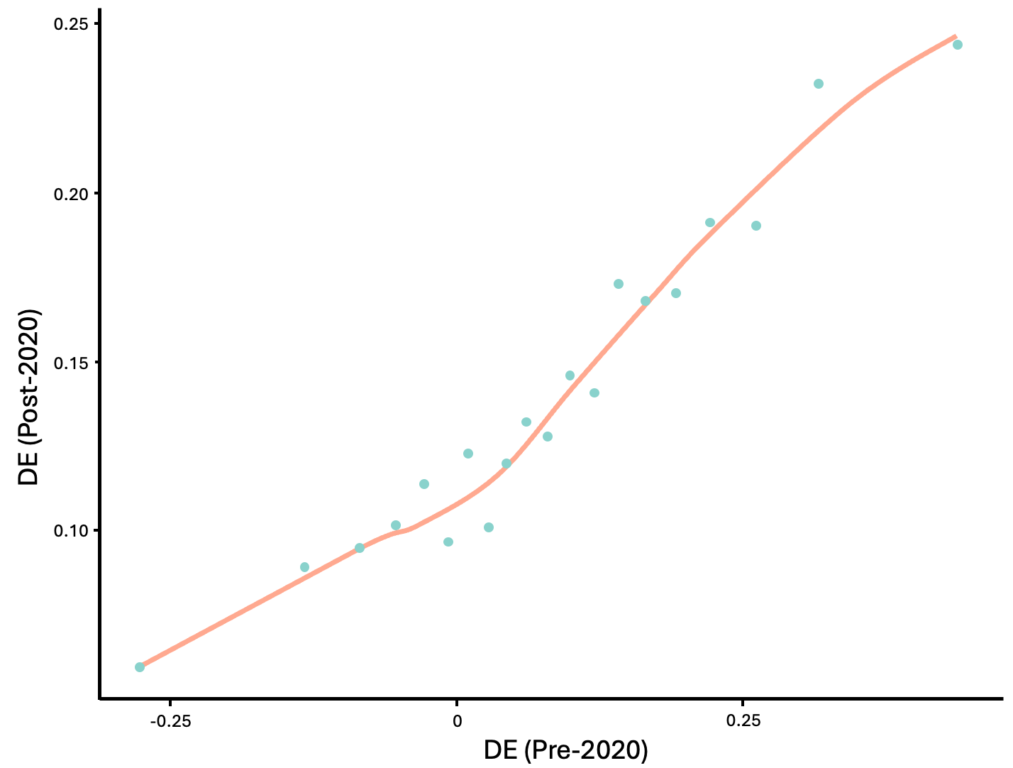
Over-time Persistence of DE
Ouyang & Ouyang
The Fixed Disposition Effect
13/30

Slide 17
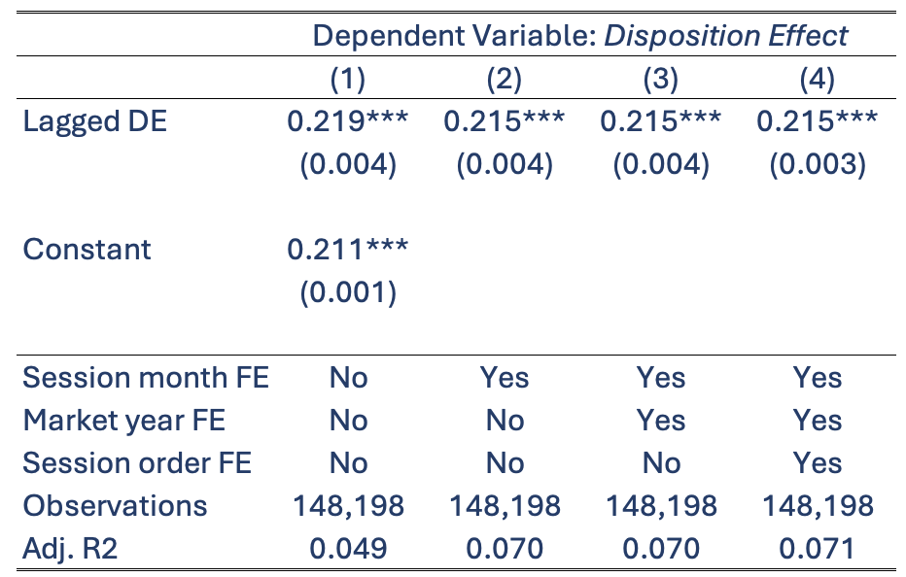
Between-session Persistence of DE
Minimal learning
Ouyang & Ouyang
The Fixed Disposition Effect
14/30

Slide 18
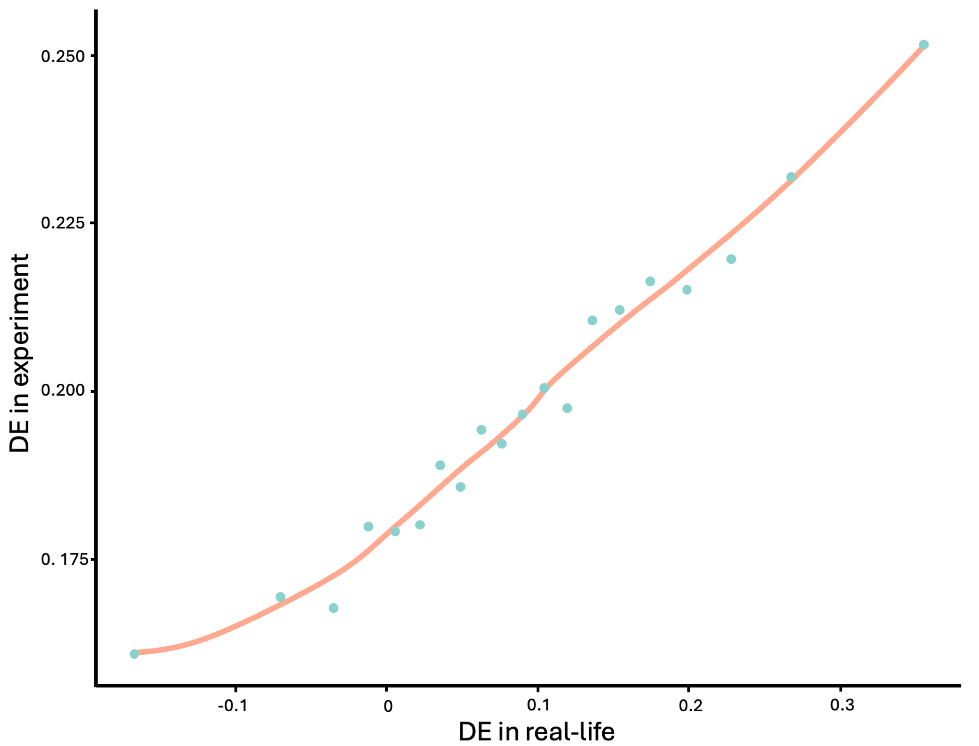
Fixed DE: Testable Prediction II
Cross-context persistence
  For the same investor, can their in-game DE predict their real-life DE?
Ouyang & Ouyang
The Fixed Disposition Effect
15/30

Slide 19
The Extrapolative Beliefs

Slide 20
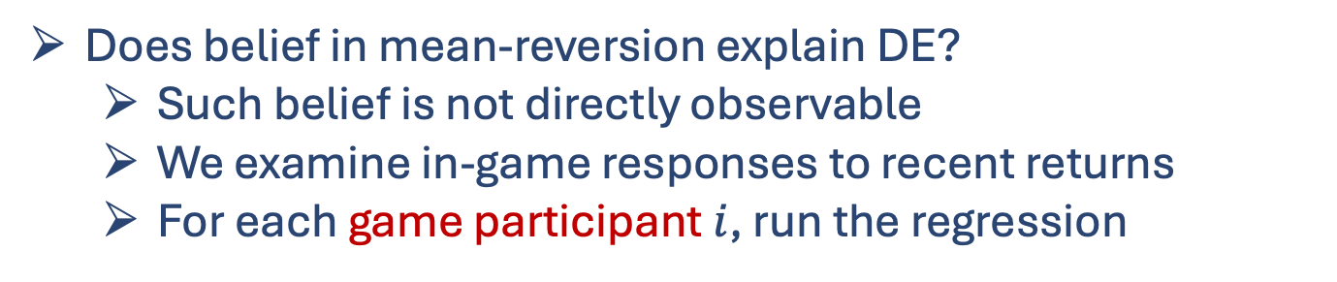
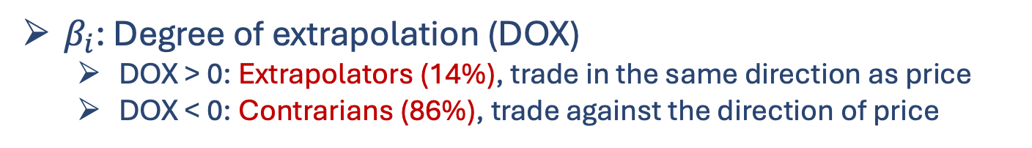

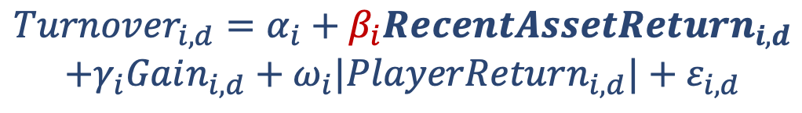
Extrapolative Beliefs: The Categorization
Does belief in mean-reversion explain DE?
  Such belief is not directly observable
  We examine in-game responses to recent returns
  For each game participant $i$, run the regression
$$Turnover_{i,d}=α_{i}+β_{i}RecentAssetReturn_{i,d}$$
$$+γ_{i}Gain_{i,d}+ω_{i}|PlayerReturn_{i,d}|+ε_{i,d}$$
$Turnover_{i,d}$: Transaction size devided by available
  In line with the user interface
$β_{i}$: Degree of extrapolation (DOX)
  DOX > 0: Extrapolators (14%), trade in the same direction as price
  DOX < 0: Contrarians (86%), trade against the direction of price
Ouyang & Ouyang
The Fixed Disposition Effect
16/30

Slide 21
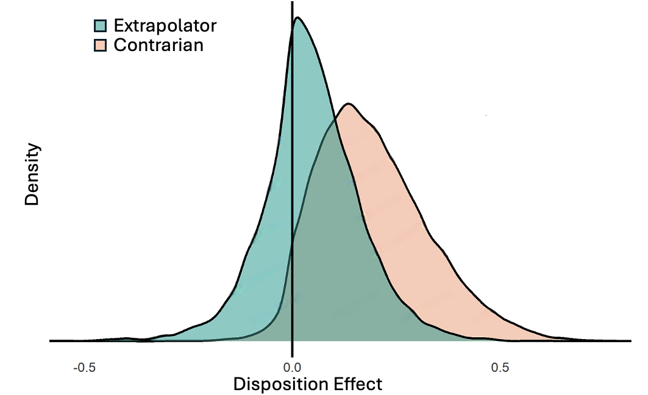
DE Distribution of Two Types (In-game)
Ouyang & Ouyang
The Fixed Disposition Effect
17/30

Slide 22
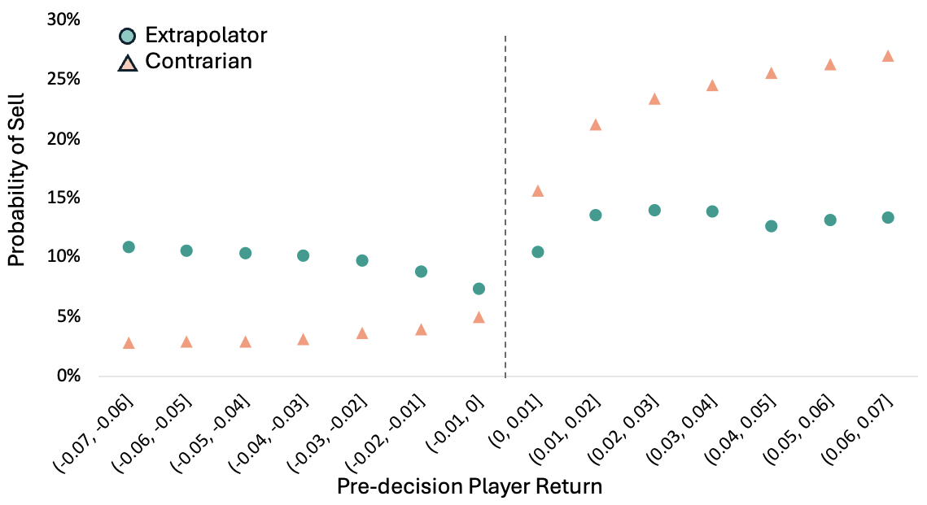
Holding Returns vs. Selling Decisions
Ouyang & Ouyang
The Fixed Disposition Effect
18/30

Slide 23
Regression Specification for In-game DE
Built on the common model (e.g., Ben-David & Hirshleifer, 2012), we examine the role of being an extrapolator:
$$100 × Sell_{i,d}=γGain_{i,d}+βGain_{i,d}×Extrapolator_{i}+η_{i}+μ_{d}+λ_{t}+ε_{i,d}$$
Return status dummy before decision d
Individual FE
Period FE: varying selling prob across game stages
Market year FE: varying selling prob across (general) market conditions
Ouyang & Ouyang
The Fixed Disposition Effect
19/30

Slide 24
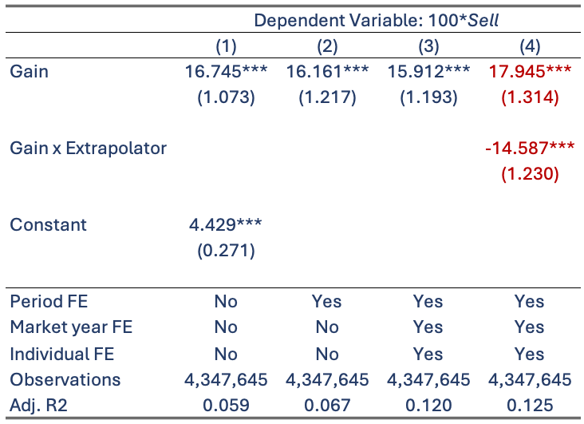
DE and Beliefs: In-game Regression
Ouyang & Ouyang
The Fixed Disposition Effect
20/30

Slide 25
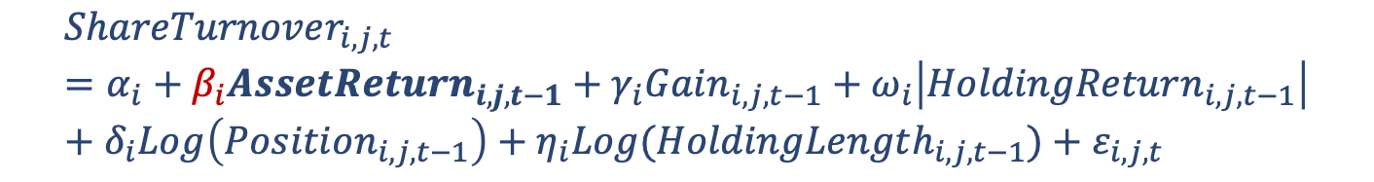
DE and Beliefs: Replication in Real Life
As the experimental setup, classify investors based on monthly mutual fund holdings:
$$ShareTurnover_{i,j,t}=α_{i}+β_{i}AssetReturn_{i,j,t−1}+γ_{i}Gain_{i,j,t−1}+ω_{i}\left|HoldingReturn_{i,j,t−1}\right|+δ_{i}Log\left(Position_{i,j,t−1}\right)+η_{i}Log(HoldingLength_{i,j,t−1})+ε_{i,j,t}$$
where
$$ShareTurnover_{i,j,t}=\frac{\#Shares_{i,j,t}−\#Shares_{i,j,t−1}}{\#Shares_{i,j,t−1}}$$
Share turnover bounded in [-1,1]
76% Contrarians + 24% Extrapolators
  Close to the in-experiment distribution
Ouyang & Ouyang
The Fixed Disposition Effect
21/30

Slide 26
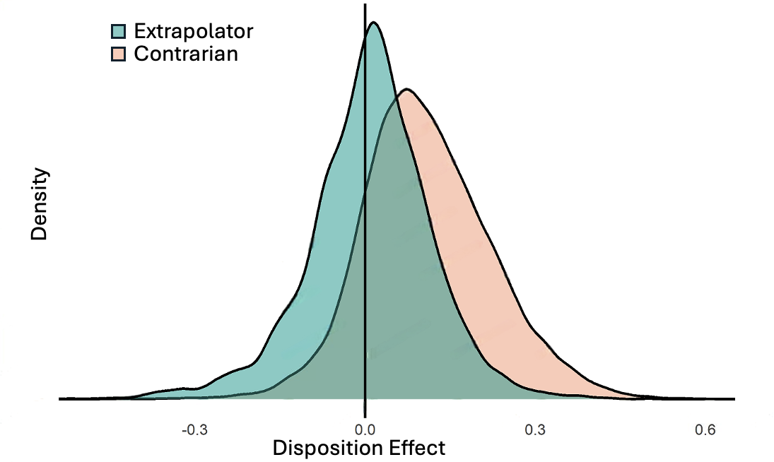
DE Distribution of Two Types (Real-life)
Ouyang & Ouyang
The Fixed Disposition Effect
22/30

Slide 27
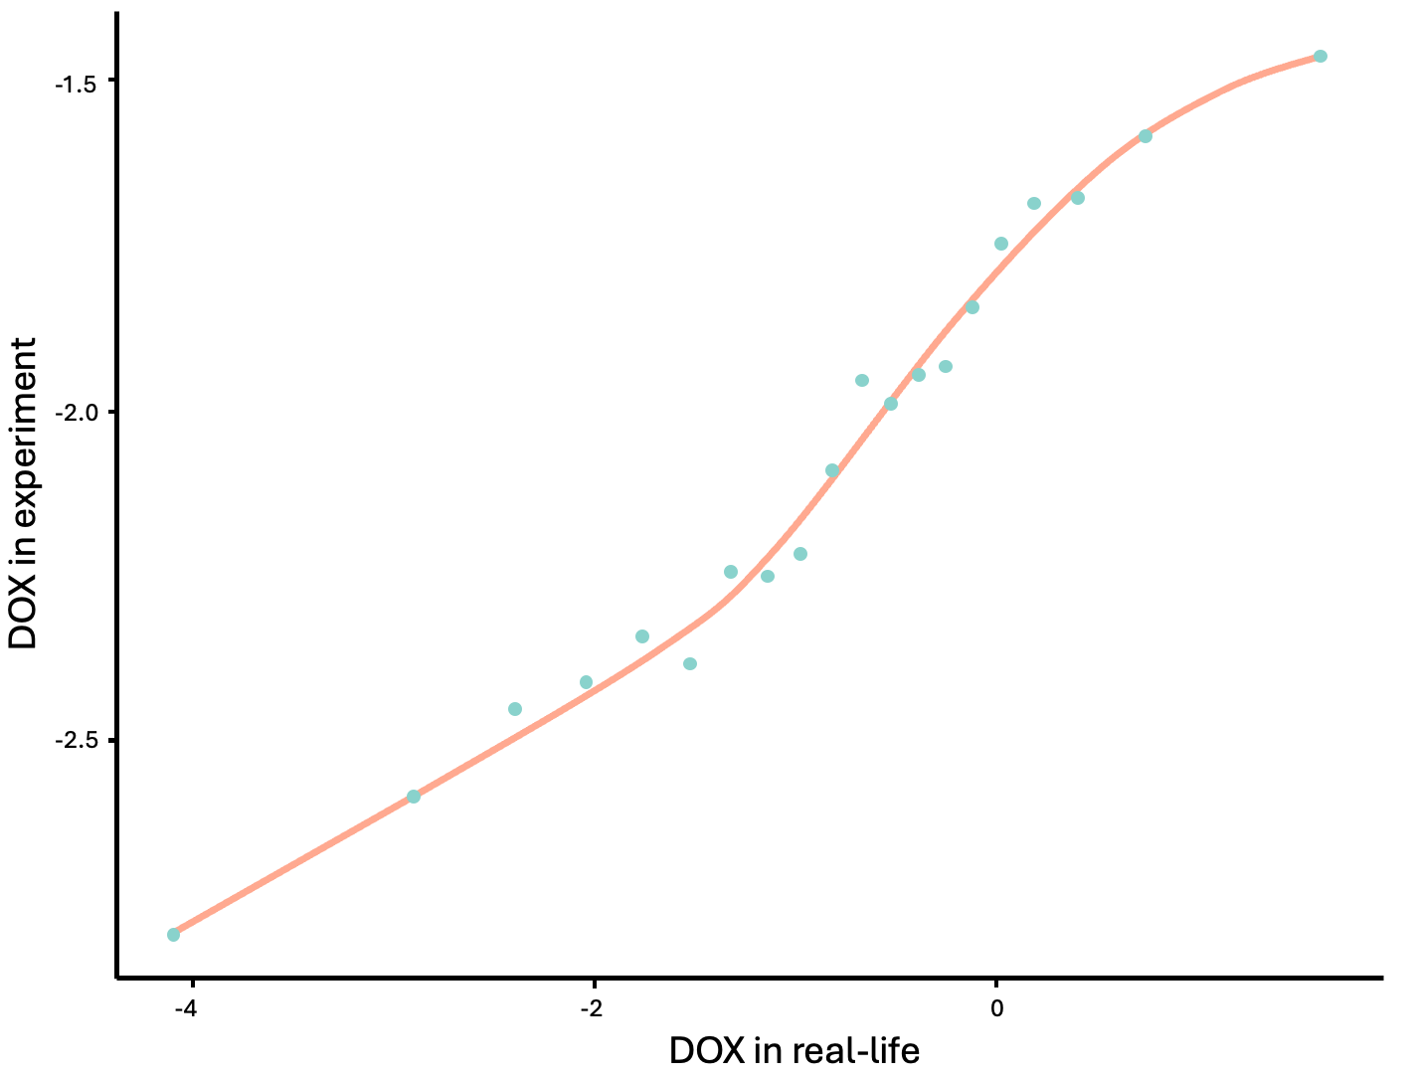
Cross-context Consistent Beliefs
Ouyang & Ouyang
The Fixed Disposition Effect
23/30

Slide 28
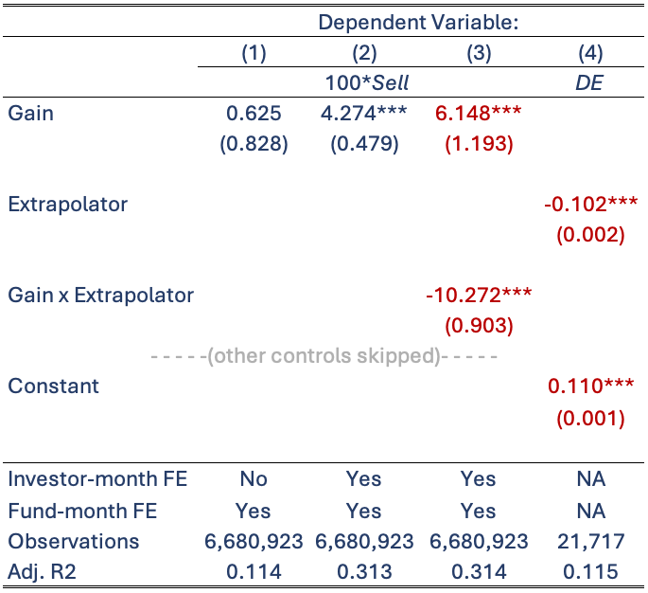
DE and Beliefs: Real-life Replication
Concern: DE and beliefs are measured in the same context…
Ouyang & Ouyang
The Fixed Disposition Effect
24/30

Slide 29
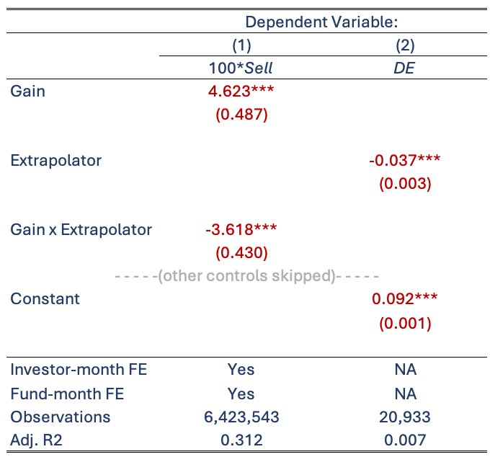
Real-life DE and Game-elicited Beliefs
Ouyang & Ouyang
The Fixed Disposition Effect
25/30

Slide 30
The Realization Preference

Slide 31
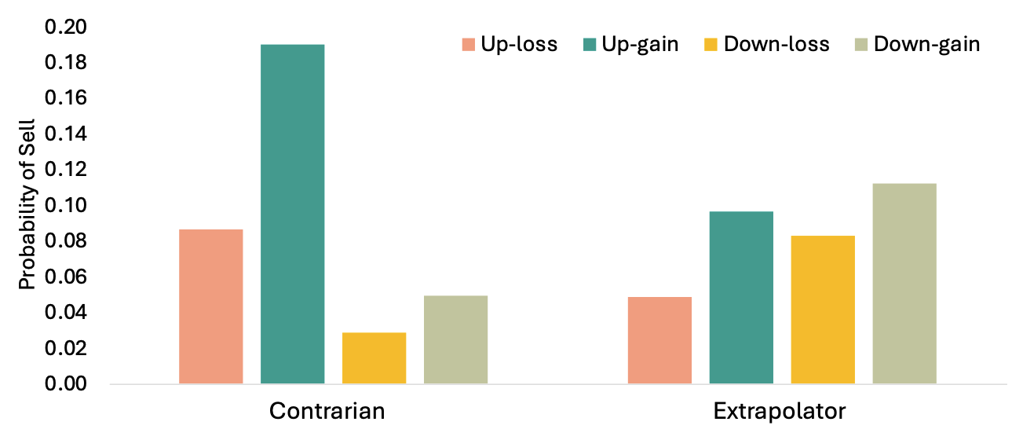
Detecting Realization Utility in Game
Within a tiny return interval [-1%,1%] in the experiment, how do the participants react to up-down vs. gain-loss?
Potentially RU-driven
Ouyang & Ouyang
The Fixed Disposition Effect
26/30

Slide 32
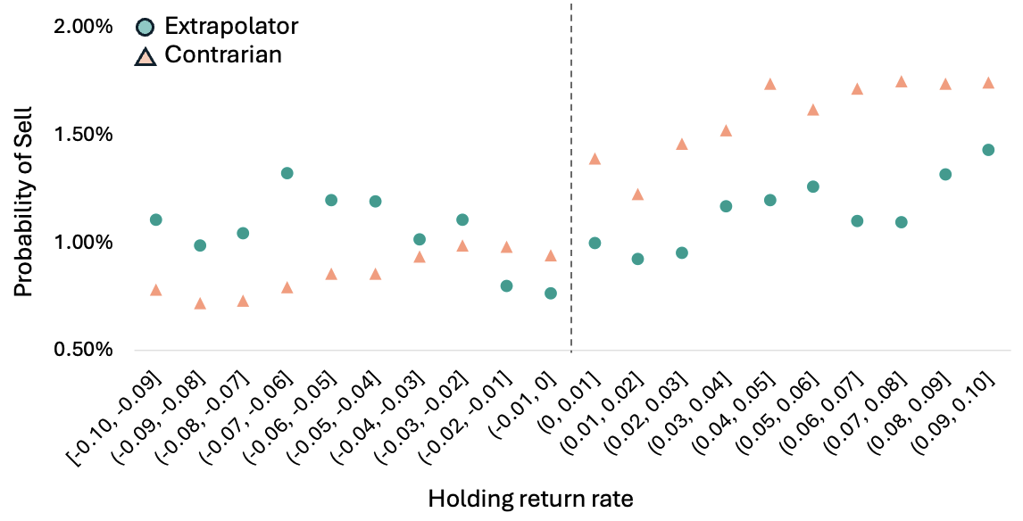
Realization Utility in Real Life
Exploit a more granular, transaction-level, dataset
Ouyang & Ouyang
The Fixed Disposition Effect
27/30

Slide 33
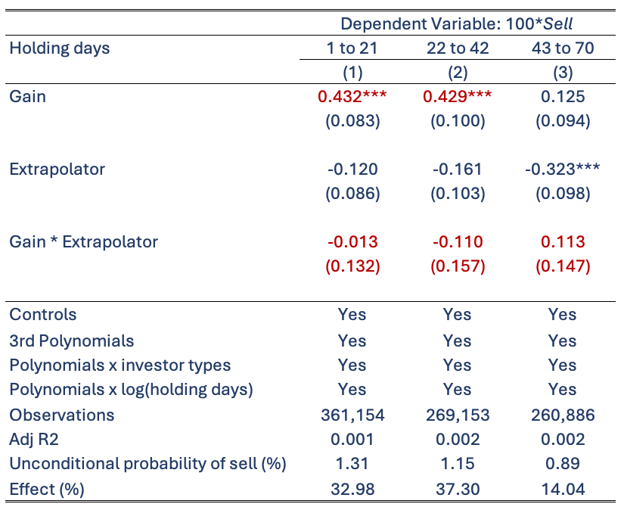
Formal Identification: RDD
Following closely Ben-David & Hirshleifer (2012)
Ouyang & Ouyang
The Fixed Disposition Effect
28/30

Slide 34
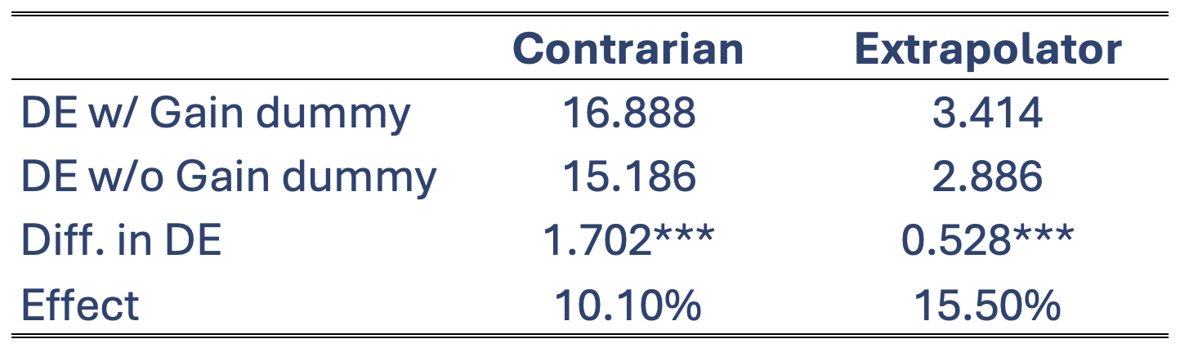
In-game Validation: Removal of the Jump
In game, fit two sets of possibility of sell
  One includes the Gain dummy as well as its interaction terms with 3rd polynomials of holding period returns
  The other excludes all Gain-dummy-related terms but otherwise remains the same
    As if realization preference no longer matters
  Then calculate the aggregate DE using fitted probs of sell
Ouyang & Ouyang
The Fixed Disposition Effect
29/30

Slide 35
Concluding Remarks
With a recent large-scale experiment + real-life data, we present evidence showing that the disposition effect is
  still prevalent at aggregate level,
  present among mutual fund investors as well, (Chang et al., 2016)
  better interpreted as an individual-specific, instead of a universal, bias
  associated with both extrapolative (mean-reverting) beliefs and realization preference
Understanding the composition of investor in terms of belief is crucial, as it offers micro-foundations for observed pricing anomalies such as price bubbles.
FinTech innovations provide massive research opportunities, while in turn, academic studies facilitate better designs.
Does DE hurt performance if capital gains are taxed differently?
Ouyang & Ouyang
The Fixed Disposition Effect
30/30

Slide 36
THANK YOU!

Slide 37
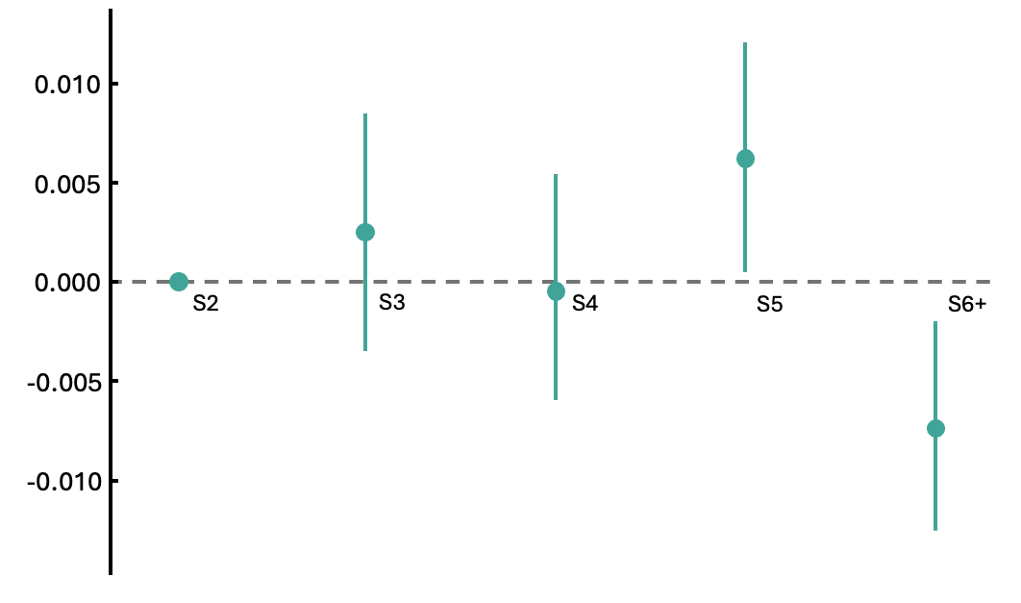

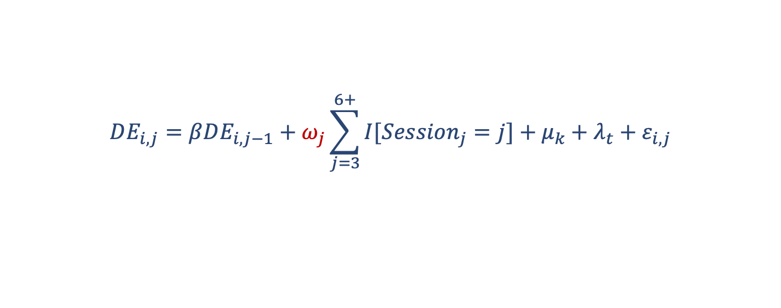
Minimal Learning about DE over Games
$$DE_{i,j}=βDE_{i,j−1}+ω_{j}\sum_{j=3}^{6+}{I[Session_{j}=j]}+μ_{k}+λ_{t}+ε_{i,j}$$
Session year-month FE: real-life conditions
In-game market year FE: experimental conditions
Mean DE of the first sessions: 0.166

